Slide 1
ATAK Plugin Development Introduction
Training
Copyright © : Adeptus Cyber Solutions, LLC : 2023

Slide 2
Agenda
About Adeptus Cyber Solutions
Pre-requisites
Exploring the SDK from tak.gov
Hello World Plugin
Keystore Setup
Building and Installing
Deploying to an Emulator
Debugging Hello World
Plugin from Scratch
Troubleshooting
Third Party Pipeline (TPP) on tak.gov
Copyright © : Adeptus Cyber Solutions, LLC : 2023

Slide 3
About Adeptus Cyber Solutions, LLC
Adeptus Cyber Solutions (ACS), where real-world problems meet cutting-edge solutions. Our team is at the forefront of Android Team Awareness Kit (ATAK) Plugin development, dedicated to crafting custom solutions for the problems you face. With a rich history of expertise, our dedicated team at ACS is at the forefront of ATAK development, bringing innovation and practical solutions to meet the unique needs of our clients.
Our ATAK Expertise: ACS has been a trailblazer in the ATAK development landscape, continuously evolving alongside the platform's advancements. With over 3 years heavily involved in the TAK ecosystem, we have consistently demonstrated our proficiency in developing tailored ATAK Plugins that cater to a diverse range of requirements. At ACS, we take pride in our extensive portfolio of successfully developed ATAK Plugins. These plugins span a spectrum of functionalities, from monitoring the health statistics of warfighters to creating seamless workflows for launching and recovering unmanned aircraft. Our commitment to delivering high-quality, robust solutions has garnered us a reputation as a trusted partner in the ATAK development ecosystem.
Elevate your ATAK experience with Adeptus Cyber Solutions. Whether you require specialized plugins, ATAK training, TAK Server support, assistance with CI/CD pipelines, or plugin quality testing we are here to assist.
Visit us at www.adeptuscybersolutions.com for more information
Copyright © : Adeptus Cyber Solutions, LLC : 2023

Slide 4
Pre-requisites
Copyright © : Adeptus Cyber Solutions, LLC : 2023

Slide 5
Pre-requisites
A Mac, Windows or Linux system to install software on
Knowledge of how to install software on your system
An understanding of Android Studio, will not be covering how to use Android Studio
Working knowledge of Android
A tak.gov account so you can obtain the SDK and submit plugins to the Third Party Pipeline
Android Studio – (https://developer.android.com/studio)
Java 11 JDK
Make sure this is the default JDK being utilized
https://docs.aws.amazon.com/corretto/latest/corretto-11-ug/downloads-list.html
Join the TAK Community on Discord
This is where you will find lots of good information and other devs willing to help
Copyright © : Adeptus Cyber Solutions, LLC : 2023
Notes:
We will be working with the 4.10 LTS release of ATAK for this training. Concepts discussed will work for previous versions of ATAK, any differences will be denoted during the training.

Slide 6
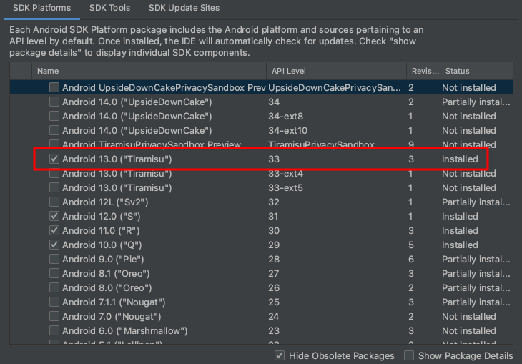
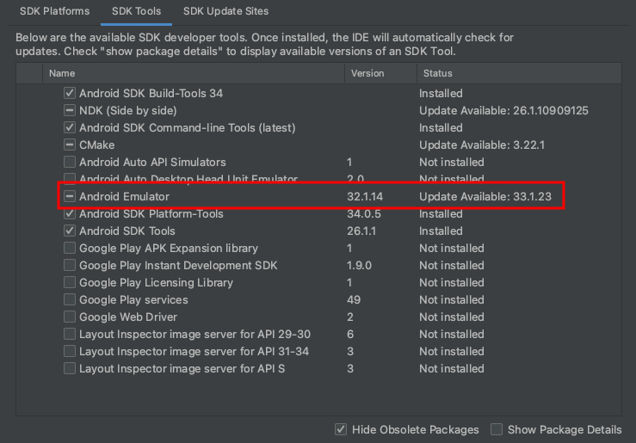
Pre-requisites: Android Studio
SDK Manager (Tools -> SDK Manager)
SDK Platform: Android 13
SDK Tools: Android Emulator
Copyright © : Adeptus Cyber Solutions, LLC : 2023

Slide 7
Exploring the SDK from tak.gov
Copyright © : Adeptus Cyber Solutions, LLC : 2023

Slide 8
Exploring the SDK from tak.gov
Download the latest ATAK 4.10 SDK
Extract the ZIP
Why not use GitHub?
Code base is older and not maintained
It’s the actual code for ATAK and not the SDK, would require you to compile it to make the SDK
This training is on how to build plugins and not ATAK
Copyright © : Adeptus Cyber Solutions, LLC : 2023
Notes:
The purpose of grabbing the SDK from tak.gov/TPC is that the GitHub repo is several versions behind the latest release of ATAK. Also what is available on GitHub is not the SDK but the source to compile the SDK. In this presentation we are learning how to build plugins and not build ATAK we will acquire the SDK from TPC.

Slide 9
Exploring the SDK from tak.gov
Sample Plugins Folder
Hello World Plugin
Plugin Template – Used to create your own templates
android_keystore – keystore used to sign plugins (note its location)
atak-gradle-takdev.jar – needed for compilation of plugins
Developer ATAK APK - install this on device or emulator
main.jar – needed for compilation of plugins
Copyright © : Adeptus Cyber Solutions, LLC : 2023
Notes:
The keystore, which is used for signing the APK prior to deployment, lives in the root of the SDK. The android_keystore, main.jar and atak-gradle-taskdev.jar need to be two levels above your plugin source code. I’d recommend renaming the atak.apk to include the version number. As new releases come out they all have an atak.apk and if you need to install a different version of the apk or have multiple APKs on your device this makes life a bit easier. Be sure to note the location of the android_keystore, this comes into play when we generate our own keystore for our plugins.

Slide 10
Hello World Plugin
Copyright © : Adeptus Cyber Solutions, LLC : 2023

Slide 11
Hello World Plugin - Setup
Need to generate keys in a keystore to sign the APK
Debug Key:
keytool –genkey –alias debug –keyalg RSA –keysize 2048 –keystore android_keystore
Release Key:
keytool –genkey –alias release –keyalg RSA –keysize 2048 –keystore android_keystore
Be sure to document the password for each key and for the keystore
Keystore should be saved to the folder two levels up from the plugin source
See “Exploring the SDK from tak.gov” slide
Copyright © : Adeptus Cyber Solutions, LLC : 2023

Slide 12
Keystore Generation
Debug Key Generation
Release Key Generation
New Keystore
Copyright © : Adeptus Cyber Solutions, LLC : 2023

Slide 13
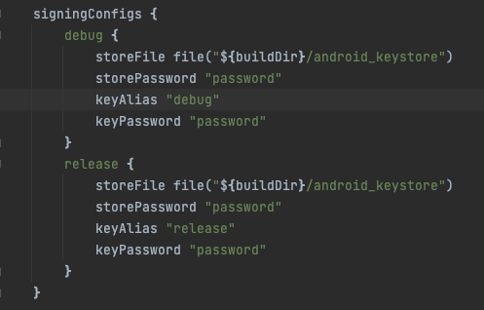
Keystore Setup
Edit the plugin’s app/build.gradle file
Locate the signingConfigs section
Updated the debug and release keys
Set the:
storePassword
keyAlias
keyPassword
Copyright © : Adeptus Cyber Solutions, LLC : 2023
Notes:
While you can use the setup that comes with the SDK, it is best practice to create your own keystore

Slide 14
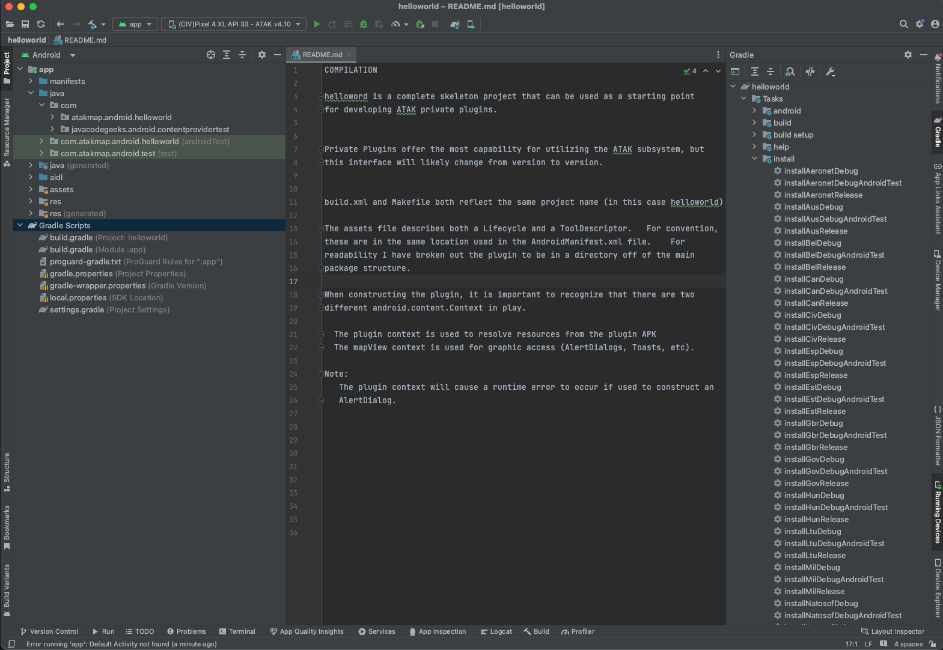
Hello World Plugin – Android Studio
Code
Gradle Task Window
Gradle Build Scripts
installCivDebug
Copyright © : Adeptus Cyber Solutions, LLC : 2023
Notes:
Get familiar with the Gradle Build window. Out of the box, the default “app” profile in android studio will not launch an ATAK Plugin. You will need to use the installCivDebug from the Gradle window to have the plugin installed onto the device or emulator.

Slide 15
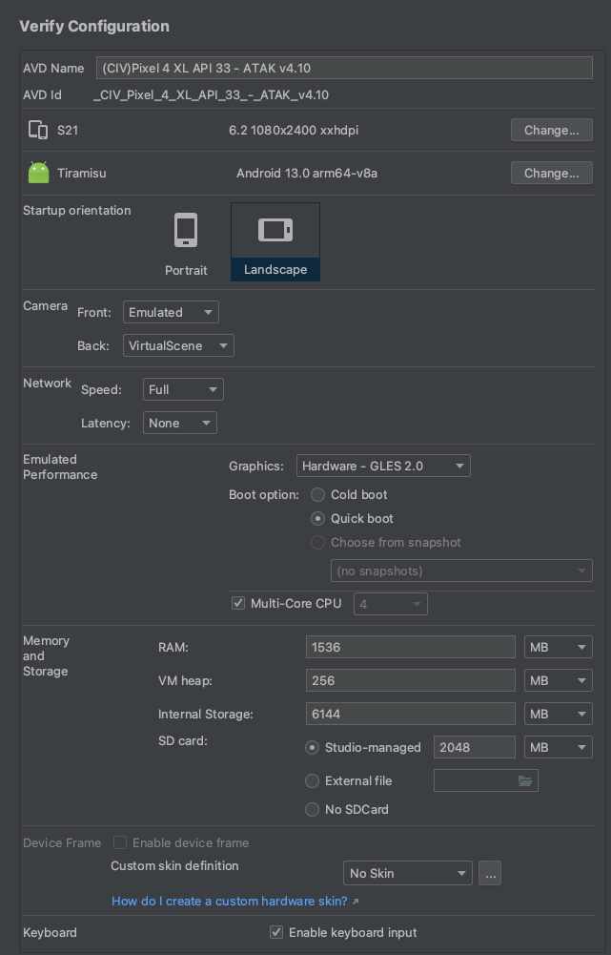
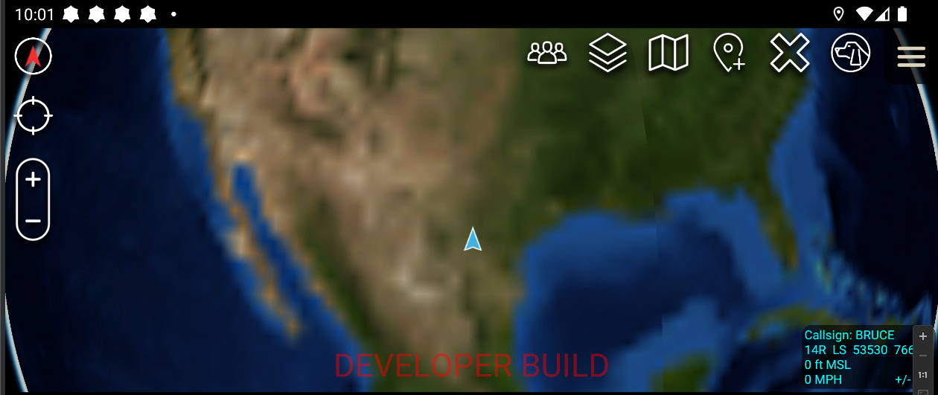
Hello World Plugin – Emulator
Configure and start an emulator
Be sure to use Android 13 as the system image
Transfer the atak.apk to the emulator and install it
Follow the setup prompts for ATAK
Similar steps for a physical device, copy ATAK APK and install it
Copyright © : Adeptus Cyber Solutions, LLC : 2023
Notes:
The common emulator settings that I use are pictured on the right The big thing here is to make sure your SD Card has several GB of space

Slide 16
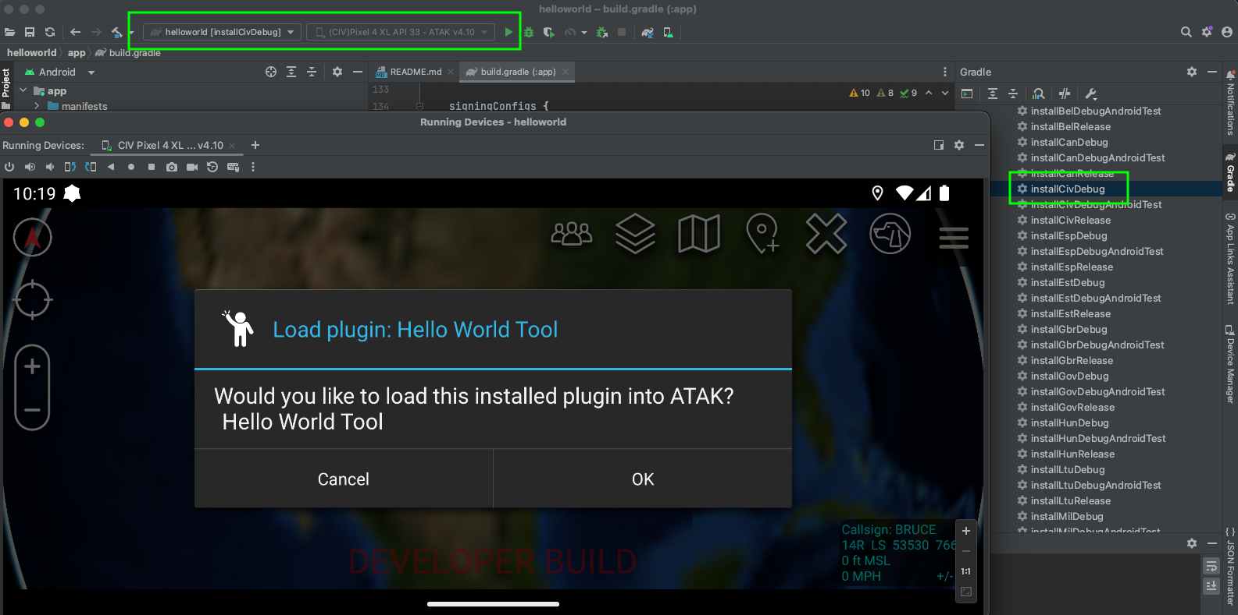
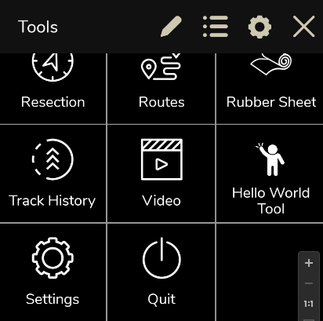
Hello World Plugin - Deployment
Emulator/Device is running and ATAK is the app that is open
Map is displayed and it says “DEVELOPER BUILD” on the bottom of the screen
From the Android Studio Gradle Task Window
Locate Tasks -> install -> installCivDebug
Double click installCivDebug
This launches the build and install of the plugin
Hello World Tool now shows in the menu
Copyright © : Adeptus Cyber Solutions, LLC : 2023

Slide 17
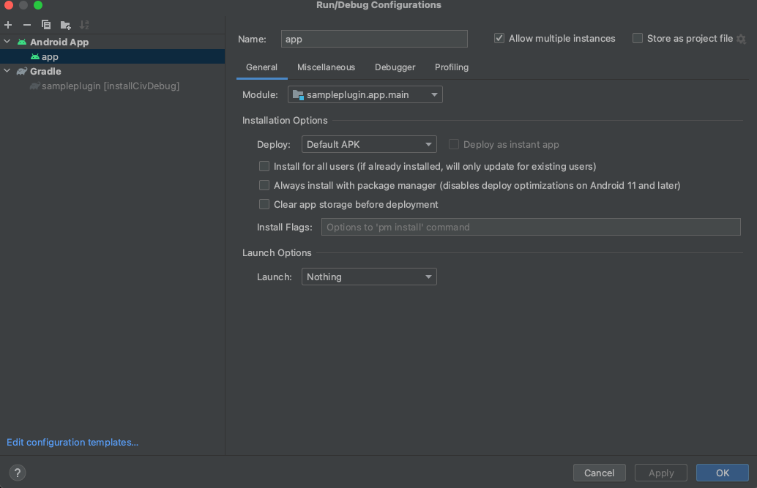
Hello World Plugin - Deployment
To correct the Android App run configuration in Android Studio
From the Run menu select Edit Configurations
Expand the Android App (if compressed)
Select app
In the Launch Options set the Launch to Nothing
Copyright © : Adeptus Cyber Solutions, LLC : 2023
Notes:
Changing this will allow you to just use the default App run configuration. This is the same as running installCivDebug.

Slide 18
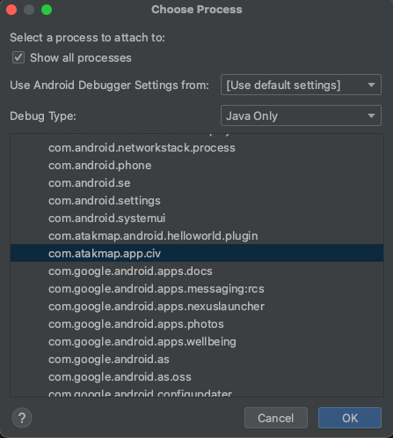
Hello World Plugin - Debugging
Since a plugin is not a true Android app you cannot click on the “Debug” button of Android Studio.
To debug a plugin:
From the Android Studio Run menu select “Attach Debugger to Android Process”
In the popup window locate the device/emulator
Expand the list an select com.atakmap.app.civ to debug
You have to connect to the ATAK app in order to debug your plugin
Once connected to ATAK, you can debug your plugin just as you would any other application
Copyright © : Adeptus Cyber Solutions, LLC : 2023
Notes:
As a warning, performance of ATAK while debugging degrades over time. This has been seen on emulators and powerful physical devices. To clear this, simply restart ATAK when you are done debugging.

Slide 19
Plugin from Scratch
Copyright © : Adeptus Cyber Solutions, LLC : 2023

Slide 20
Plugin Development Cycle
Start with the plugintemplate from the SDK
Develop your plugin, testing with the SDK provided ATAK APK
Once ready to deploy, send plugin code to Third Party Pipeline (TPP).
Version of ATAK to build against is defined in the app/build.gradle
Will compile a release build of your plugin
Will sign your plugin for release
Release version of plugins will only work in release versions of ATAK
Debug versions of plugins will only work in debug versions of ATAK
The version of ATAK the plugin was built for needs to match the version of ATAK.
For example:
A 4.9 plugin will NOT work on ATAK 4.8.1
A 4.8.1 plugin will NOT work on ATAK 4.9
This changes in ATAK 5.0, there is backwards compatibility with 4.10
Copyright © : Adeptus Cyber Solutions, LLC : 2023
Notes:
Due to certificate validation plugins will only work in certain builds of ATAK. For one, the official release build of ATAK is signed by the TPC. All plugins that need to work in a release build need to be run through the TPP in order to be signed by TPC. The debug version of ATAK, removes the certificate check so any signed plugin will work. Also a release build uses proguard to obfuscate the code, debug builds do not. This is another reason why release builds will not work in debug and visa-versa as the plugin will not be able to locate the library calls from the main jar file. The backwards compatibility of plugins is new in 5.0 and it was only released a week prior to this training.

Slide 21
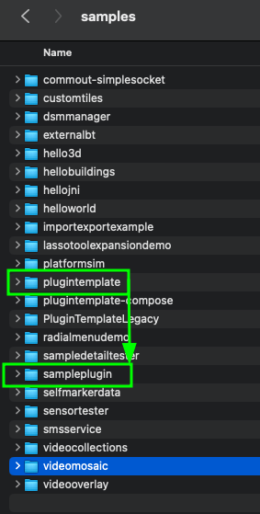
Plugin from Scratch - Setup
tak.gov provides in the SDK a plugintemplate that is used as the basis for any new plugin
Copy the existing plugintemplate in the SDK folder to a new folder called sampleplugin
Open the sampleplugin in Android Studio
Open the proguard-gradle.txt
At the bottom, change the PluginTemplate in the repackageclasses setting to something meaningful. Otherwise the TPP build will fail.
In the Java code
Rename the plugintemplate portion of the package to something meaningful
Rename the PluginTemplate class to something meaningful
Also adjust the package to the R import to match what was just set
In the AndroidManifest.xml
Update the package to match the name of the package that was just renamed
In the assets folder
Edit the plugin.xml and update the package name
In the res/values folder
Edit the strings.xml file and change the name of the app
Copyright © : Adeptus Cyber Solutions, LLC : 2023

Slide 22
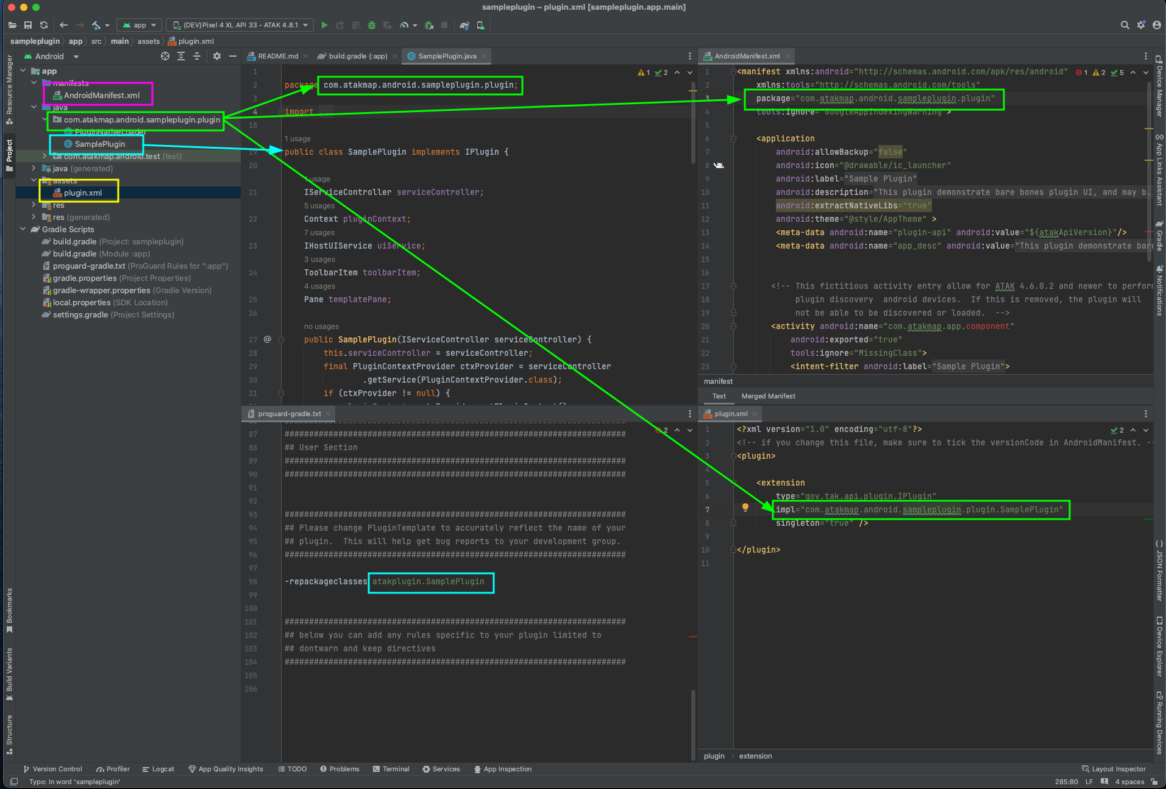
Plugin from Scratch - Setup
Copyright © : Adeptus Cyber Solutions, LLC : 2023

Slide 23
Plugin from Scratch - Setup
Edit the plugin’s app/build.gradle file
Locate the signingConfigs section
Updated the debug and release keys
Set the:
storePassword
keyAlias
keyPassword
Copyright © : Adeptus Cyber Solutions, LLC : 2023

Slide 24
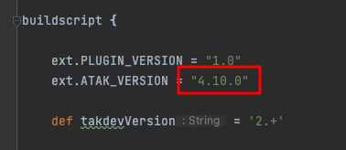
Plugin from Scratch – ATAK Version
In order to support other versions of ATAK, the plugin has to be compiled against the correct main.jar and the version has to be set in the app/build.gradle
When you submit your plugint to TPP, this variable in the app/build.gradle is used to determine the ATAK build environment
If you need to test your plugin against ATAK 4.9, for example, you need to acquire the 4.9 SDK from tak.gov and change out the main.jar and change this variable to say “4.9.0”
Copyright © : Adeptus Cyber Solutions, LLC : 2023
Notes:
Beacuase you need to change out the main.jar to compile against a different version of ATAK, I prefer to keep each plugin in its own folder structure. This also helps when managing the code in a source code repository such as git. You might be able to get away with compiling against the ATAK 4.9 main.jar for a 4.8.1 plugin but there are API changes between the two and you might run into inconsistencies. For example, back in 4.5, the name of the coordinate entry dialog window change in the API. So we needed to correct that in our plugins and support both ATAK 4.4 and 4.5 with code changes. While the 4.4 version of the code would compile with the 4.5 API, it would not launch the UI when activated.

Slide 25
Plugin from Scratch - Building
Now that everything is setup we can do a build
Open the Gradle Task Window and locate the assembleCivDebug task
Double click this task to start a build of the plugin
This will only compile your plugin and not install it
Correct any build errors and try again
Once you are satisfied with you build, run installCivDebug to install the plugin in ATAK
Copyright © : Adeptus Cyber Solutions, LLC : 2023

Slide 26
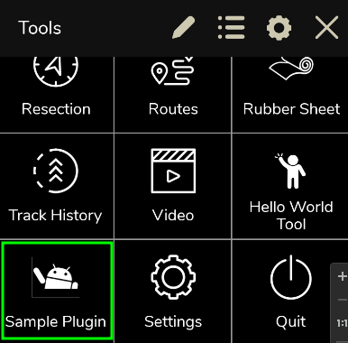
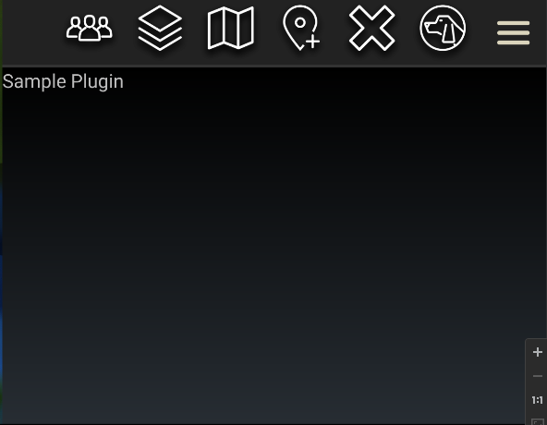
Plugin from Scratch - Running
Your plugin should now appear on the menu
To change the icon, change the res/drawable/ic_launcher.png
This is defined in the AndroidManifest.xml
Click on your icon to launch your plugin
Copyright © : Adeptus Cyber Solutions, LLC : 2023
Notes:
While you can use the setup that comes with the SDK, it is best practice to create your own keystore

Slide 27
Third Party Pipeline on tak.gov
Copyright © : Adeptus Cyber Solutions, LLC : 2023

Slide 28
Third Party Pipeline on tak.gov
To have your plugin work on the full CIV version of ATAK it must be signed by the TAK Product Center (TPC) via the Third Party Pipeline (TPP)
Simply zip the folder that contains your plugin and submit it to the TPP
In the previous example, we would zip the SamplePlugin folder
Recommend doing a clean before zipping to reduce the artifacts that are in the zip
Login to tak.gov and goto Resources -> Third Party Pipeline
Upload the zip and submit
You will receive an email notification:
When build begins
Complete of build (success or failure)
Failure will contain a build log that will need to be reviewed
Copyright © : Adeptus Cyber Solutions, LLC : 2023
Notes:
Builds on TPP can take any where from immediate to hours to start depending on the load. Generally once a build starts it takes about 10 minutes to complete as the TPP has to spin up and setup a docker container for your build. A new container is spun up for every plugin that is submitted.

Slide 29
Troubleshooting
Copyright © : Adeptus Cyber Solutions, LLC : 2023

Slide 30
Troubleshooting
If you are seeing old log statements that you have removed or weird behaviors in your plugin after several deployments during development, restart ATAK
This is due to the way that ATAK loads a plugin, it does not always unload the previous version of the Java class file. So, you could have old code still running.
This is only really an issue during development as we are constantly pushing new versions to the emulator/device.
A restart of ATAK clears out all the old class files.
Copyright © : Adeptus Cyber Solutions, LLC : 2023

Slide 31
Questions?
Contact us: info@adeptus-cs.com
Visit our website: www.adeptuscybersolutions.com
Copyright © : Adeptus Cyber Solutions, LLC : 2023

